Slide 1
KeepTrack!
JEDI
Judicial Engineering by Denver Innovators
4/23/2017

Slide 2
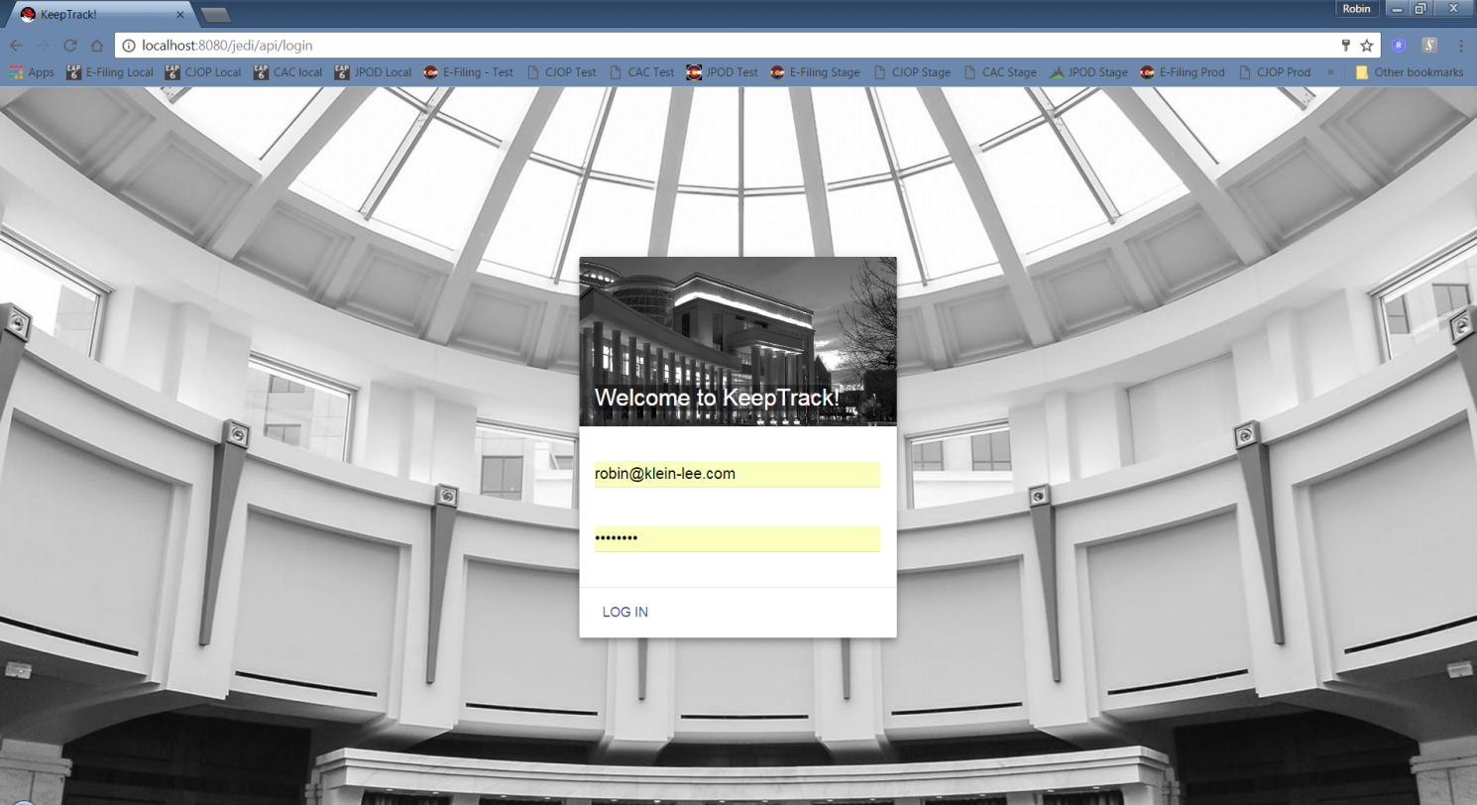
Login Screen

Slide 3
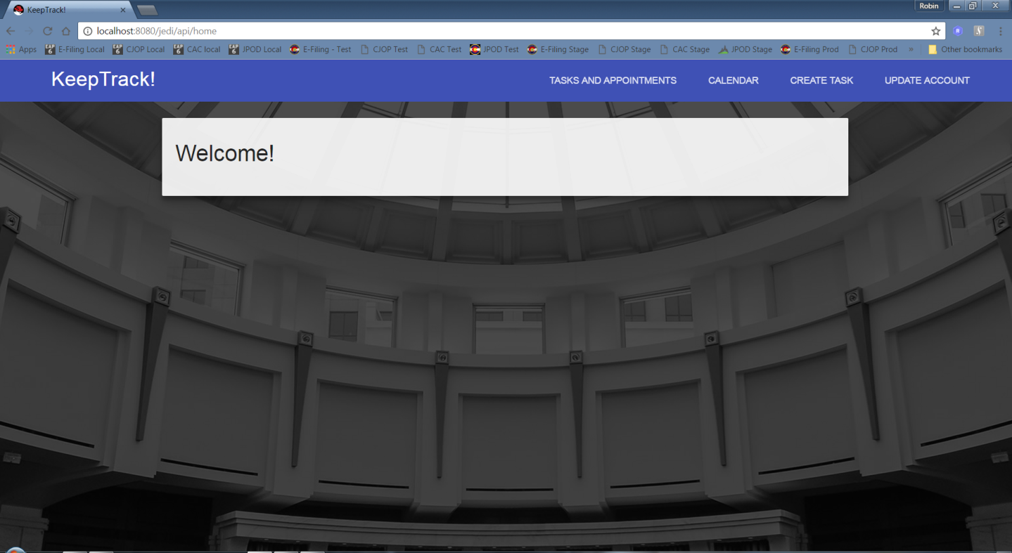
Customer Home Screen

Slide 4
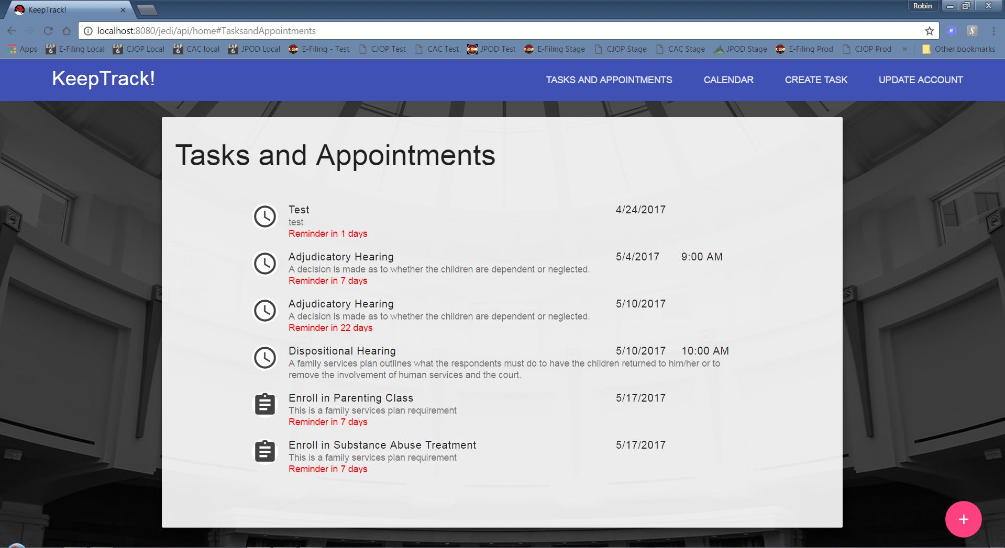
Customer Tasks and Appointments

Slide 5
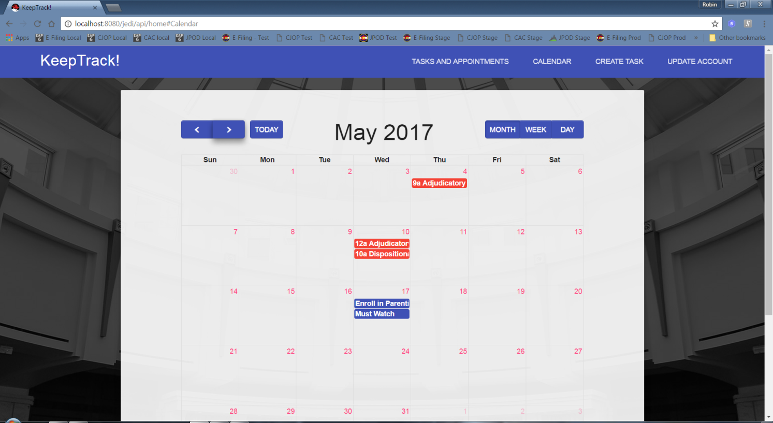
Customer Calendar View

Slide 6
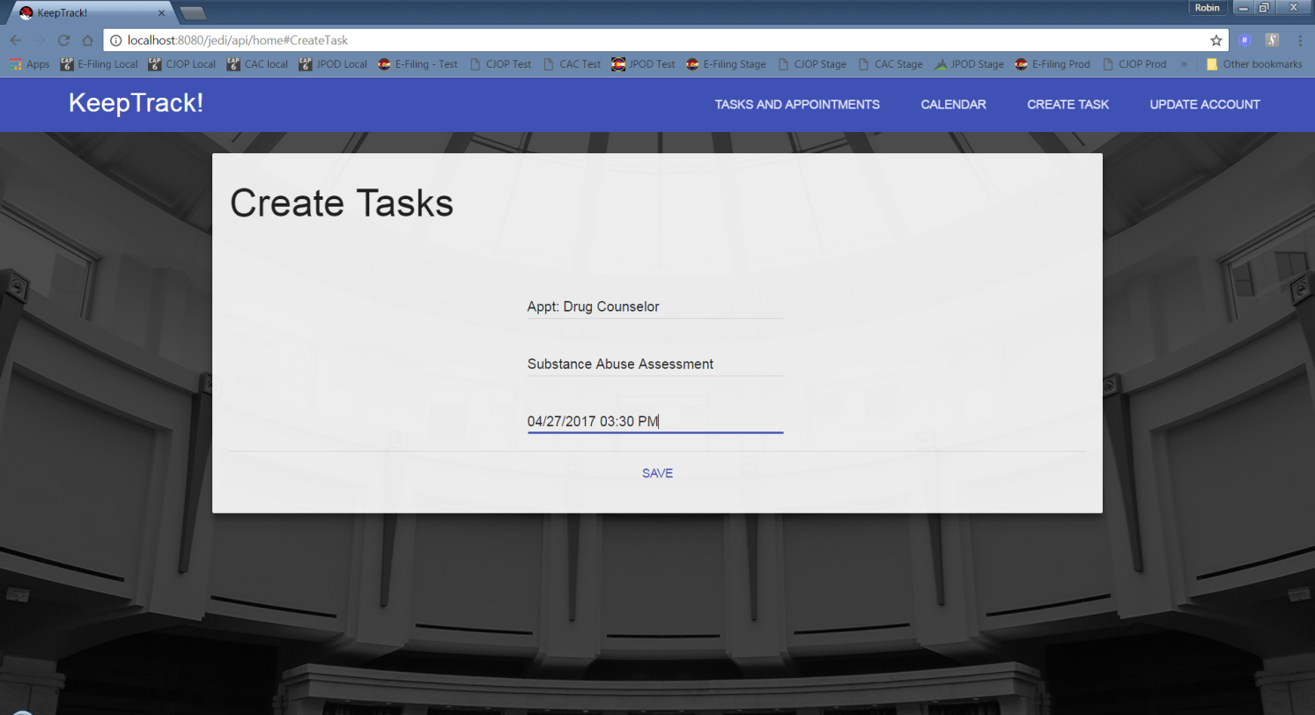
Customer Create Task

Slide 7
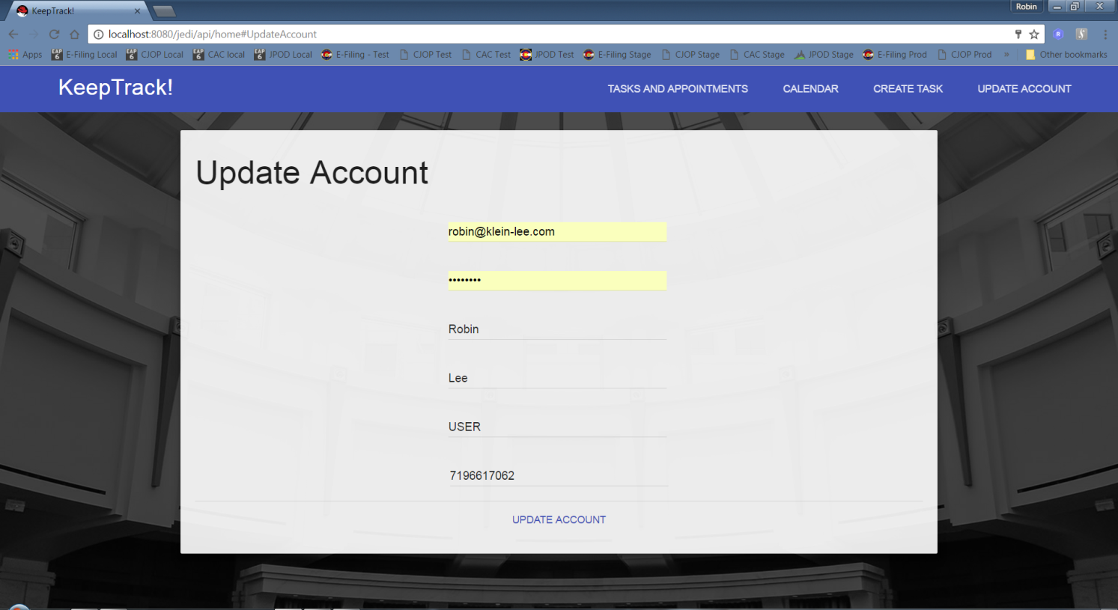
Customer Update Profile

Slide 8
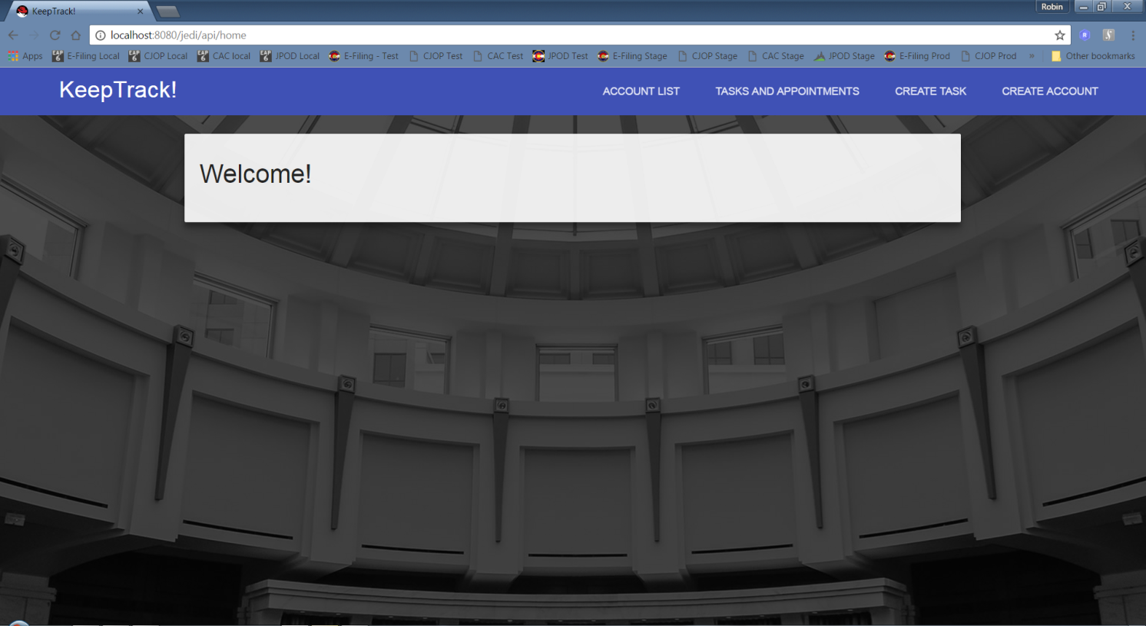
Administrator Home Screen

Slide 9
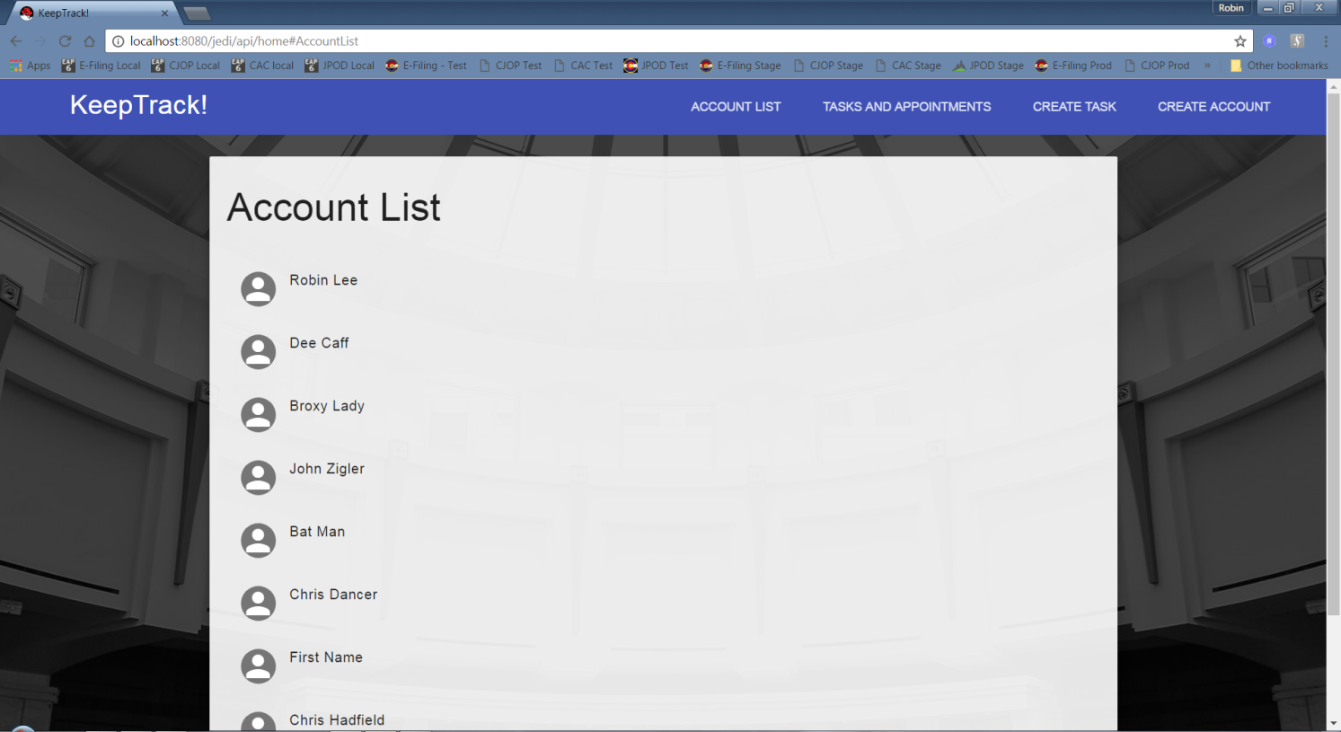
Administrator Account List

Slide 10
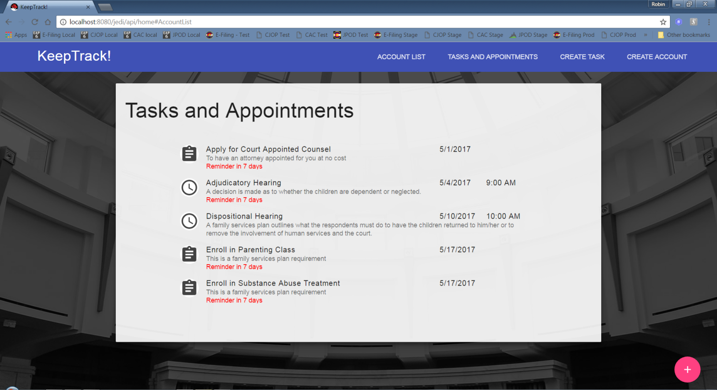
Administrator View of Customer Tasks and Appointments

Slide 11
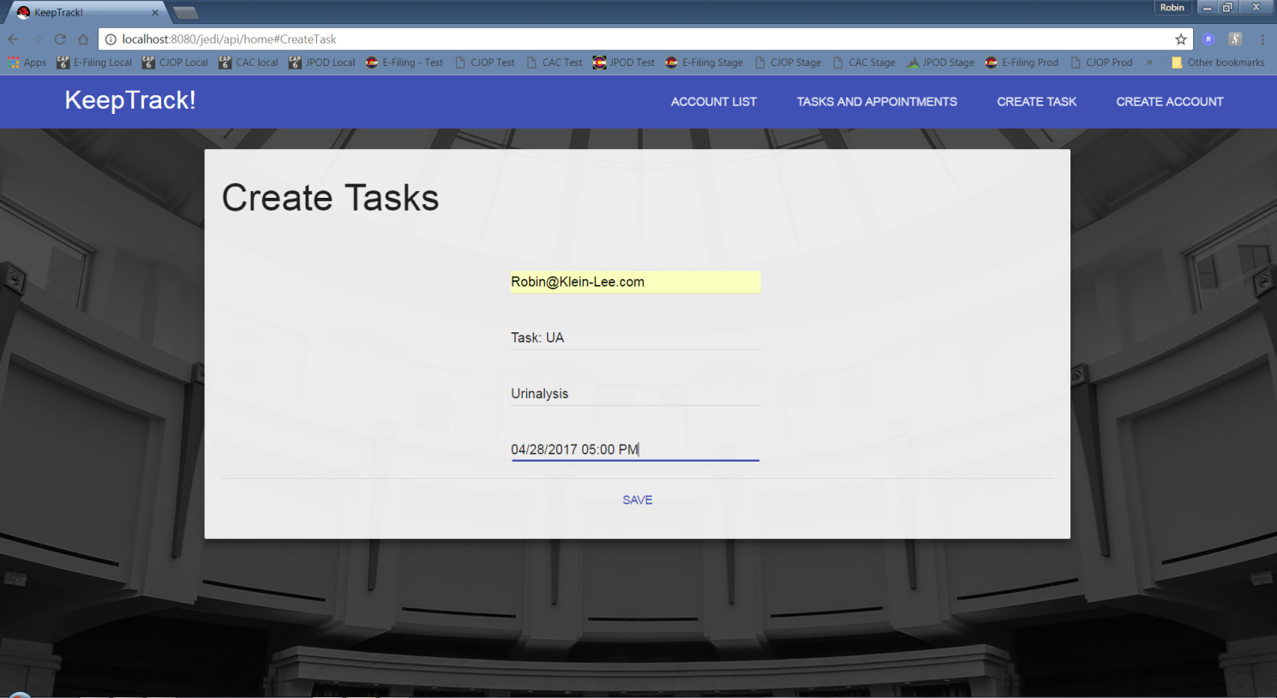
Create Task for the Customer

Slide 12
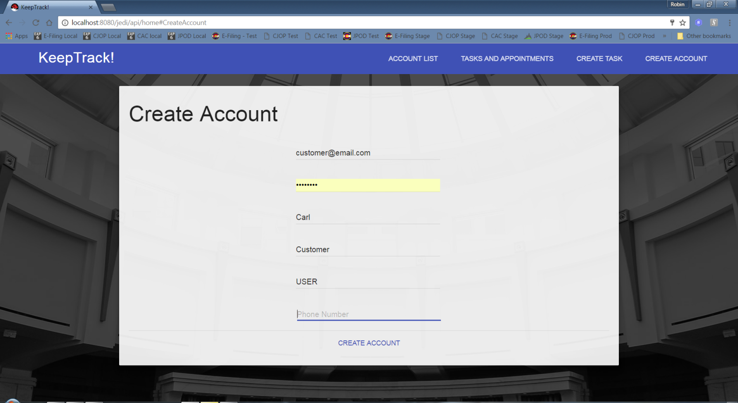
Create an Account for a Customer

